Slide 1
03/08/24

Slide 2
Linear Regression vs Logistic Regression
 | Linear Regression | Logistic Regression
Purpose | Used for predicting a continuous outcome variable based on one or more predictor variables. It establishes a linear relationship between the input features and the output. | Used for predicting the probability of an event happening (binary outcome, usually 0 or 1). Commonly used for classification problems, where the output is a categorical variable.
Output | The output is a continuous value. For example, predicting house prices, temperature, or sales amount. | The output is a probability value between 0 and 1, representing the likelihood of belonging to a certain class. Often used for binary classification problems.

Slide 3
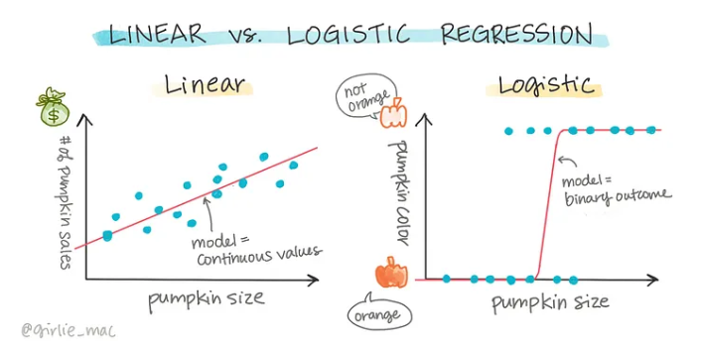

Slide 4
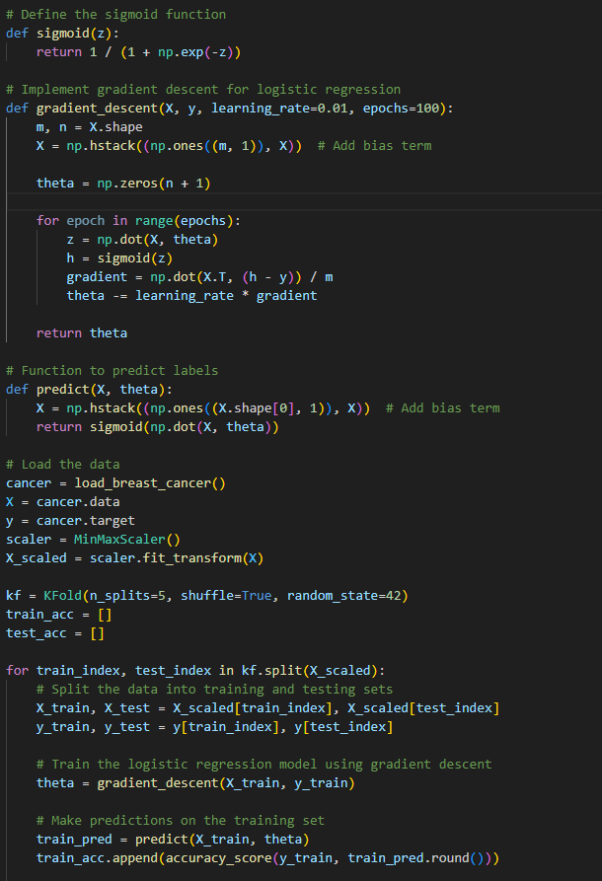
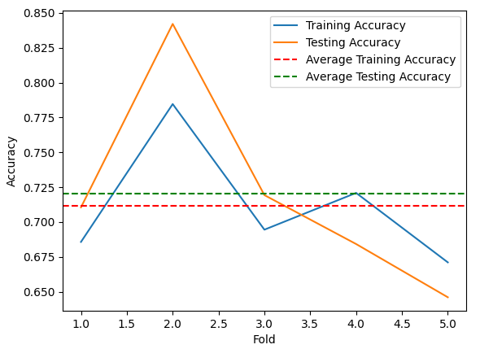
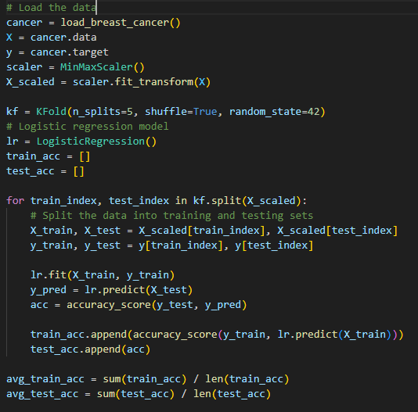
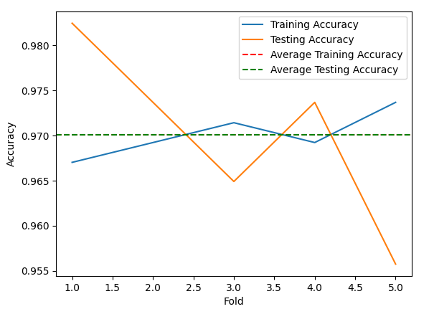



Slide 5
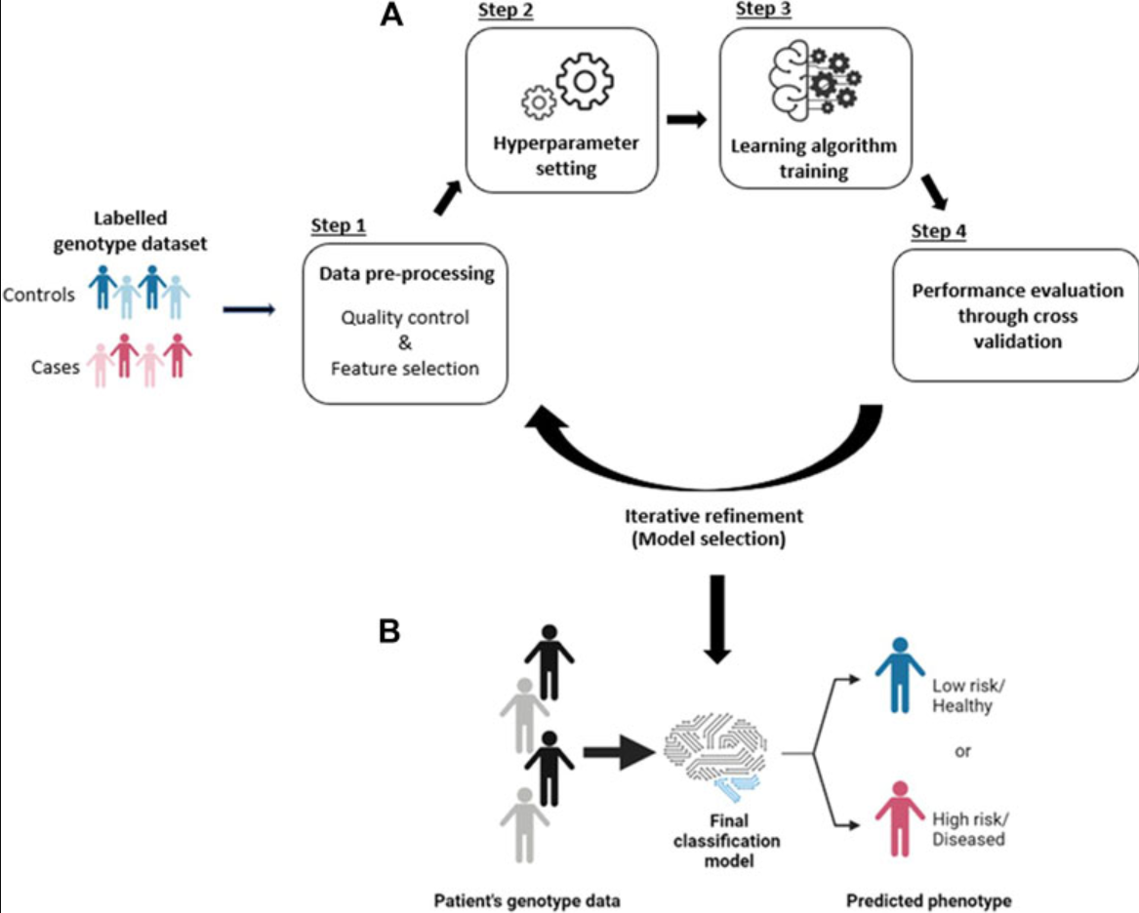
A Review of Feature Selection Methods for Machine Learning-Based Disease Risk Prediction 2022
The article explores various methods for feature selection in the context of genome-wide SNP datasets, with a focus on their application in machine learning (ML) for predicting complex traits or disease outcomes.
The analysis covers three main sections:
Univariate and Multivariate Methods,
Wrapper and Embedded Methods, and
Hybrid Methods.

Slide 6
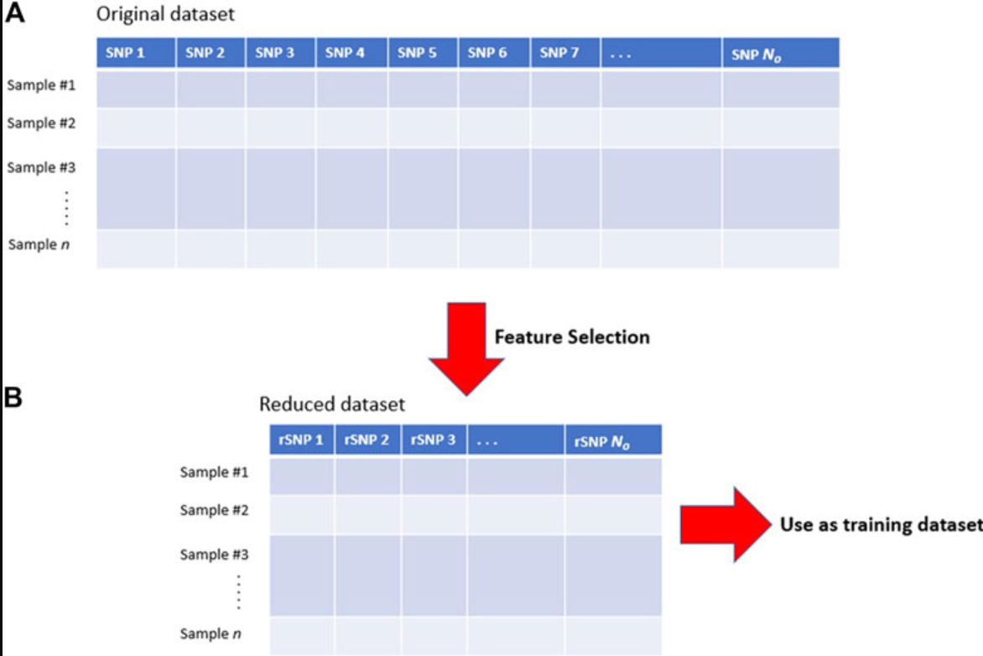

Slide 7
Univariate and Multivariate Methods
Univariate Methods: these methods evaluate each feature independently based on statistical
Multivariate Methods: these methods consider relationships between multiple features simultaneously.
Strengths:
Univariate methods are computationally efficient and straightforward, providing a quick initial screening of potentially relevant features.
Multivariate methods, such as mutual information and correlation-based approaches, capture complex relationships between features.
Limitations:
Univariate methods may overlook interactions between features, limiting their effectiveness in capturing the complexity of genetic interactions.
The choice of correlation metrics in multivariate methods can impact the results.
Insights:
The section emphasizes the need for multivariate methods to capture feature interactions and dependencies, especially in the context of SNP datasets.

Slide 8
Wrapper and Embedded Methods:
Wrapper Methods: these methods evaluate subsets of features using a predictive model.
Embedded Methods: these methods naturally embed feature selection within the model training
Strengths:
Wrapper methods, like recursive feature elimination (RFE), consider feature subsets and model interactions, potentially providing better predictive performance.
Embedded methods, such as decision tree-based algorithms, naturally capture feature interactions during model training.
Limitations:
Wrapper methods can be computationally expensive and prone to overfitting, particularly with high-dimensional datasets.
Embedded methods may have limitations in detecting complex higher-order interactions.
Insights:
The trade-off between computational complexity and predictive performance is highlighted, emphasizing the need for careful consideration in method selection.

Slide 9
Hybrid Methods—Combining Different Feature Selection Approaches:
Definition: Hybrid methods combine different feature selection methods in a multi-step process.
Strengths:
Hybrid methods offer a middle ground between simple filter methods and computationally complex wrapper and embedded methods.
Combining different methods in a multi-step process allows for improved performance without excessive computational burden.
Limitations:
Relevant interacting SNPs with no significant individual effects may be lost during the filtering step.
Hybrid methods still involve a trade-off between complexity and performance.
Insights:
The article presents real-world examples of successful hybrid approaches, showcasing their superiority over individual methods in certain scenarios.

